Slide 1
Janus Protein Tyrosine Kinase (JAK)
Pharmaron CADD
Yingchun Cai
Sep. 26, 2019

Slide 2
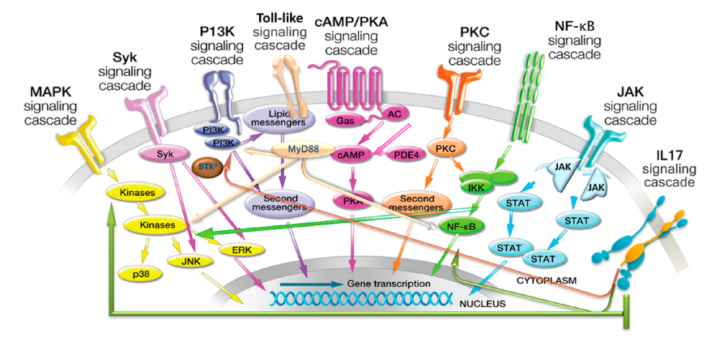
JAK2 Background
Cytokine receptor superfamilies and associated signal transduction pathways.
J. Med. Chem. 2014, 57, 5023−5038
Notes:
many cytokine receptors lack intrinsic kinase activity, instead relying on associated tyrosine kinases, such as the JAKs to transmit signals from the extracellular environment to the nucleus. Consequently, many cytokines and growth factors important for a variety of immune, inﬂammatory, and hematopoietic functions signal through JAK/STAT.

Slide 3
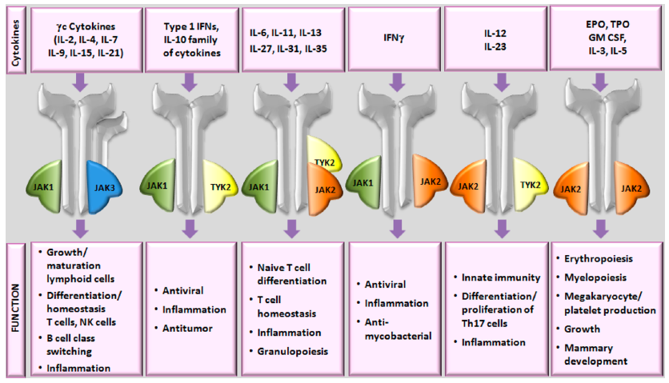
JAK2 Background
JAK2 is a member of the Janus kinase (JAK) family of non-receptor tyrosine kinases comprising four family members (JAK1, JAK2, JAK3 and TYK2). The JAKs play a critical role in both innate and adaptive immunity as well as hematopoiesis, making them attractive targets for a number of therapeutic indications.
Biological signiﬁcance of signaling through diﬀerent JAK combinations.
J. Med. Chem. 2014, 57, 5023−5038

Slide 4
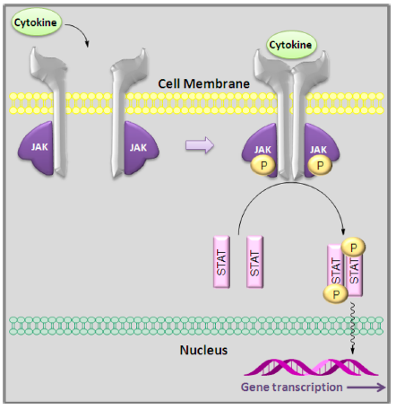
Mechanism of action of JAK2
Phosphorylation
Cytokine signaling through the JAK/STAT pathway
Current Opinion in Pharmacology 2012, 12:464–470
Notes:
Cytokine binding to the receptor leads to JAK activation and phosphorylation of the JAKs and associated receptors. Phosphorylation of the receptors in turn initiates recruitment of the STATs via their SH2 domains and subsequent phosphorylation of STAT proteins. The phosphorylated STAT homodimers or heterodimers then translocate to the nucleus where they bind to speciﬁc DNA binding sites regulating gene transcription that leads to changes in cellular function.

Slide 5
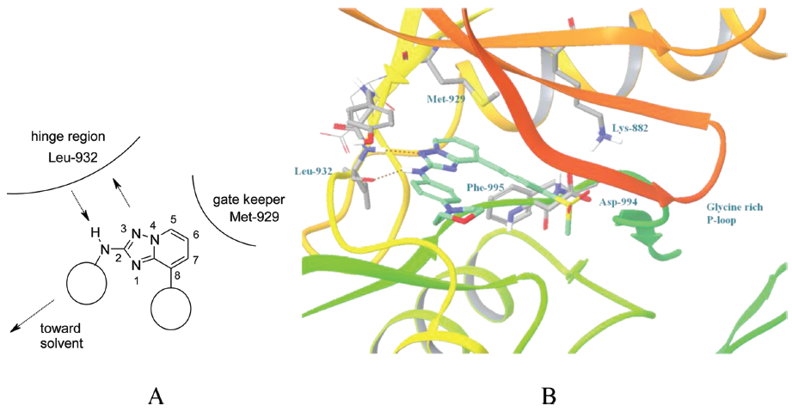
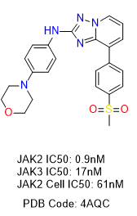
Crystal Structure
There are a total of 84 human JAK2 crystal structures (with different inhibitors)
Key amino acid residues: gatekeeper Met-929, hinge binder Leu-932 (H-bonds), and back-pocket salt-bridge of Asp-994 and Lys-882 are explicitly shown in element color-coded stick model. (PDB Code: 4AQC)
J. Med. Chem.201255115243-5254

Slide 6
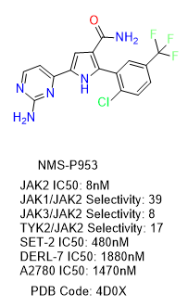
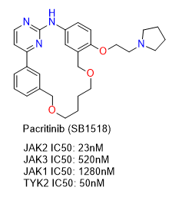
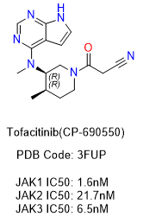
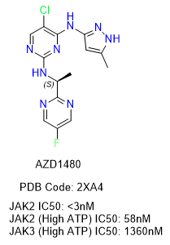
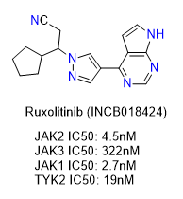
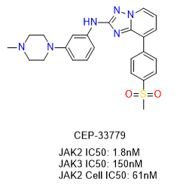
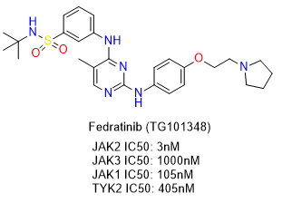
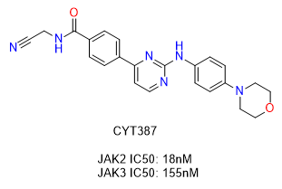
JAK2 Inhibitors

Slide 7
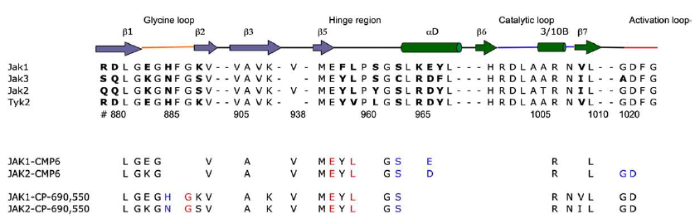
Selectivity: Sequence Alignment
Amino acid sequence alignment of the ATP-binding site region of human JAK1 PTK domain with the other members of the JAK family, JAK2 and JAK3. Residues that are not conserved within the JAK family are depicted in boldface. Residues that interact with the inhibitors through hydrogen bonds are in red, whereas those that interact through water-mediated hydrogen bonds are in blue.
J. Mol. Biol. (2009) 387, 219–232

Slide 8
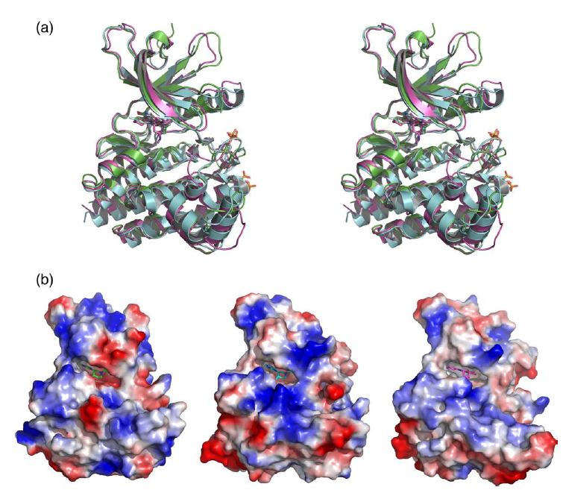
Selectivity: Comparison of Crystal Structures
Comparison of the JAK1 PTK crystal structure with JAK2 and JAK3. (a) Divergent stereoview of the superposition of JAK1 PTK (green) and JAK2 PTK (cyan) incomplex with CMP6 and JAK3 PTK incomplex with AFN941 (magenta). (b) Molecular surface representation of JAK1 PTK (left panel) and JAK2 PTK (middle panel) in complex with CP-690,550 and JAK3 PTK in complex with AFN941.
J. Mol. Biol. (2009) 387, 219–232

Slide 9
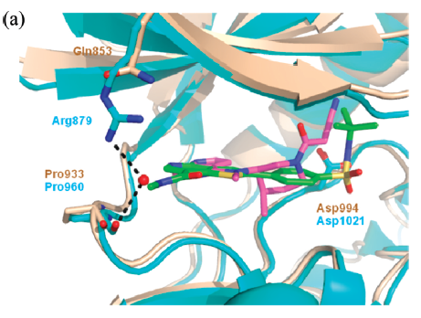
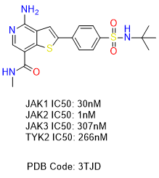
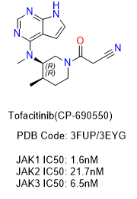
Selectivity: JAK2 VS JAK1
19
20
Overlay of the X-ray cocrystal structures of 19 (PDB ID: 3TJD) bound to Jak2 (tan) and 20 (PDB ID: 3EYG) bound to Jak1 (blue).
J. Med. Chem. 2011, 54, 8440−8450

Slide 10
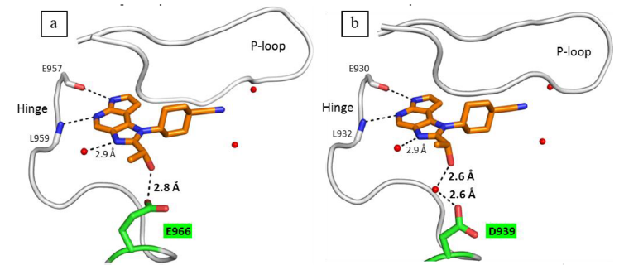
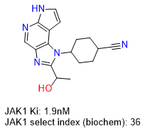
Selectivity: JAK2 VS JAK1
31
(a) X-ray structure of 31 in complex with JAK1 (PDB 4IVB, resolution = 1.9 Å). (b) X-ray structure of 31 in complex with JAK2 (PDB 4IVA, resolution = 1.5 Å). A key residue diﬀerence between JAK1 (E966) and JAK2 (D939) is highlighted in green. Notable crystallographic waters are highlighted as red spheres.
J. Med. Chem.2013,56,11,4764-4785

Slide 11
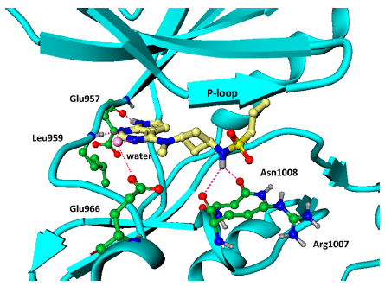
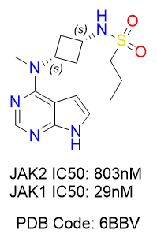
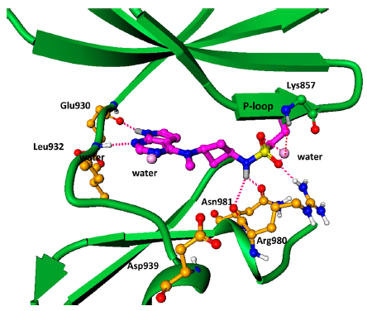
Selectivity: JAK2 VS JAK1
25
X-ray crystal structure of 25 in complex with JAK1 (top, PDB Code: 6BBU) and JAK2 (bottom, PDB Code: 6BBV).
J. Med. Chem. 2018, 61, 1130−1152
Notes:
X-ray crystal structure of 25 in complex with JAK1. The ligand 25 is shown in yellow. Hydrogen bond interactions of the core pyrrolopyrimidine ring with hinge residues Leu959, Glu957, and the NH group with Asn1008 are highlighted in red.

Slide 12
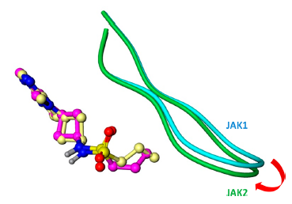
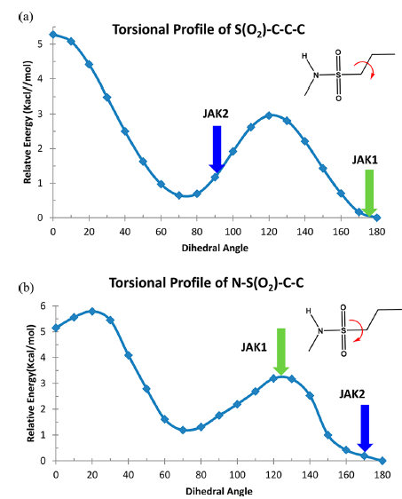
Selectivity: JAK2 VS JAK1
Orientations of the P-loops in JAK1 (cyan) and JAK2 (green) in the ligand 25 bound X-ray structures. The JAK1 bound ligand is shown in yellow, while the JAK2 bound ligand is shown in magenta.
Torsional proﬁle of the dihedral (a) S(O2)−C−C−C and (b) N−S(O2)−C−C calculated from B3LYP/6-31++G basis set. Green and blue arrows indicate observed dihedrals in the X-ray bound state of 25 in JAK1 and JAK2, respectively.
J. Med. Chem. 2018, 61, 1130−1152
Notes:
X-ray crystal structure of 25 in complex with JAK1. The ligand 25 is shown in yellow. Hydrogen bond interactions of the core pyrrolopyrimidine ring with hinge residues Leu959, Glu957, and the NH group with Asn1008 are highlighted in red.

Slide 13
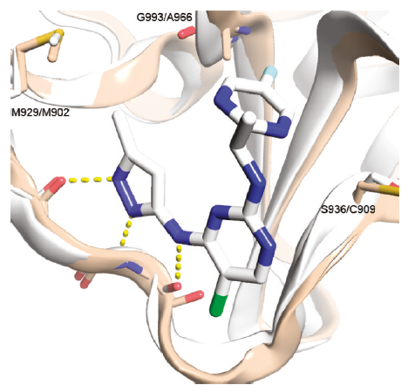
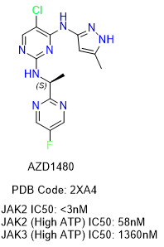
Selectivity: JAK2 VS JAK3
9e
Contribution of G993/A966 residue to the observed selectivity of 9e for Jak2 versus Jak3. Protein backbone atoms of 2XA4 (white) and 1YVJ (wheat) overlaid and represented as cartoon. Hydrogen bonds between compound 9e and the protein are shown in yellow.
J. Med. Chem. 2011, 54, 262–276

Slide 14
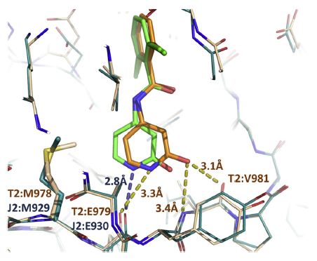
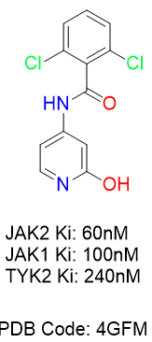
Selectivity: JAK2 VS TYK2
41
Co-crystal structures of compound 41 with JAK2 (ligand in green, protein in blue, ) and with TYK2 (ligand in orange, protein in salmon). Selected distances between core atoms and hinge are shown, as well as names and numbers of relevant residues (TYK2 in deep orange, JAK2 in deep blue).
European Journal of Medicinal Chemistry 67 (2013) 175-187

